Slide 1


Decision Trees (Classification and Regression Trees)
Wake Forest
School of Business
_______
BAN 6025

Slide 2
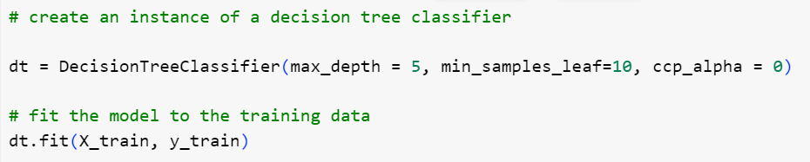
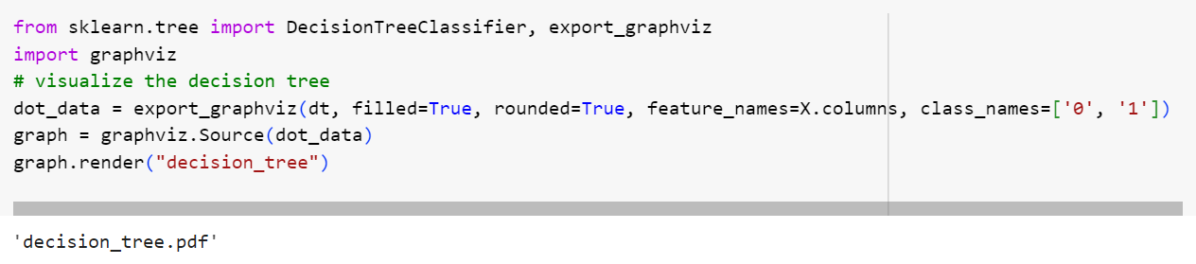
Decision Tree for the Portuguese Bank Case

Slide 3
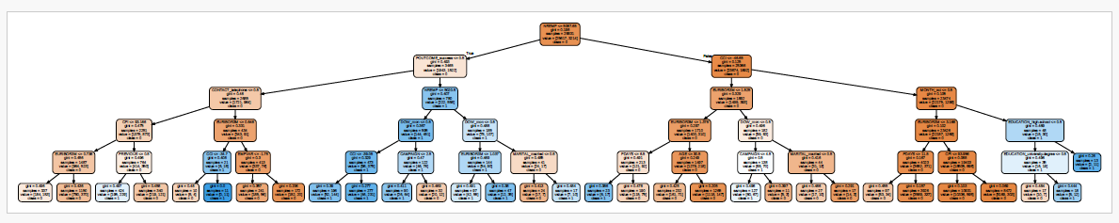
The Tree

Slide 4
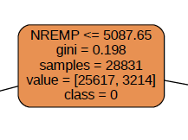
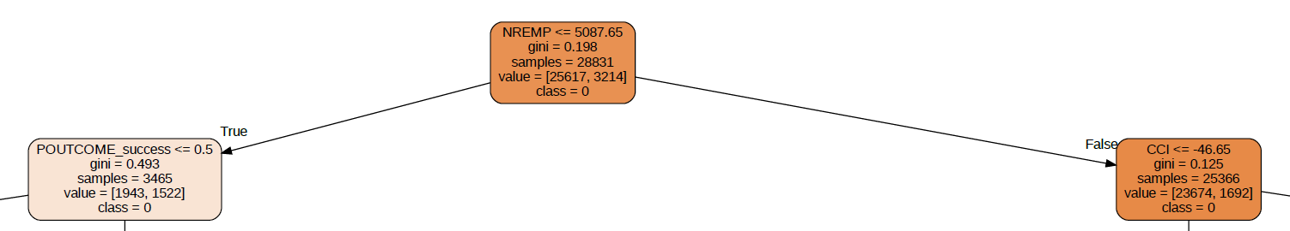
The Tree

Slide 5
The Tree

Slide 6
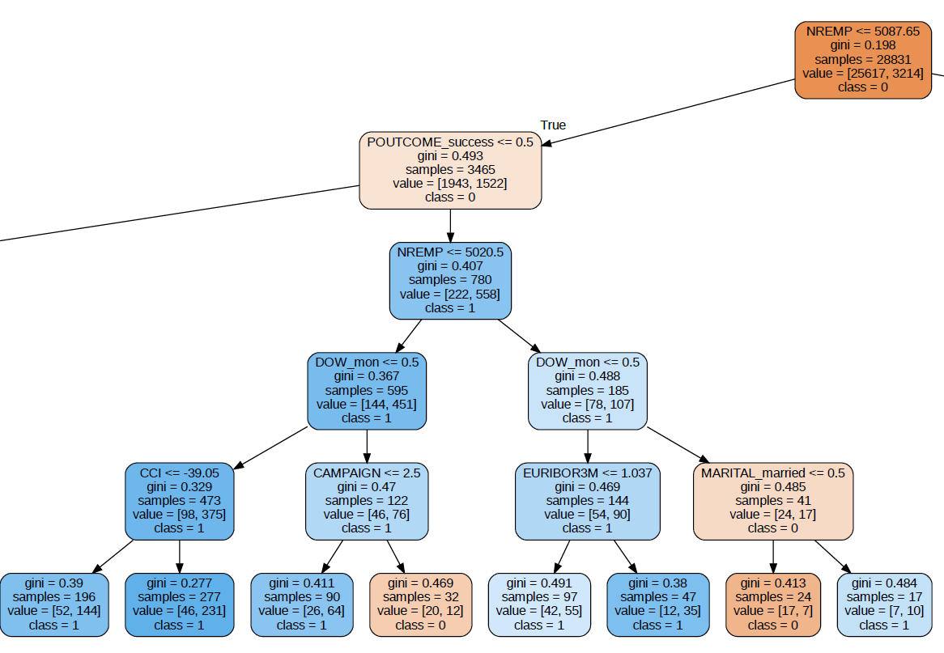
The Tree

Slide 7


Making a Prediction
Economic Conditions:
Number employed (NREMP) is 4237
Campaign Timing:
Phone calls being made on Monday morning
Customer:
Was contacted once during the last campaign
Responded positively to the last campaign
71% chance of responding “YES”

Slide 8
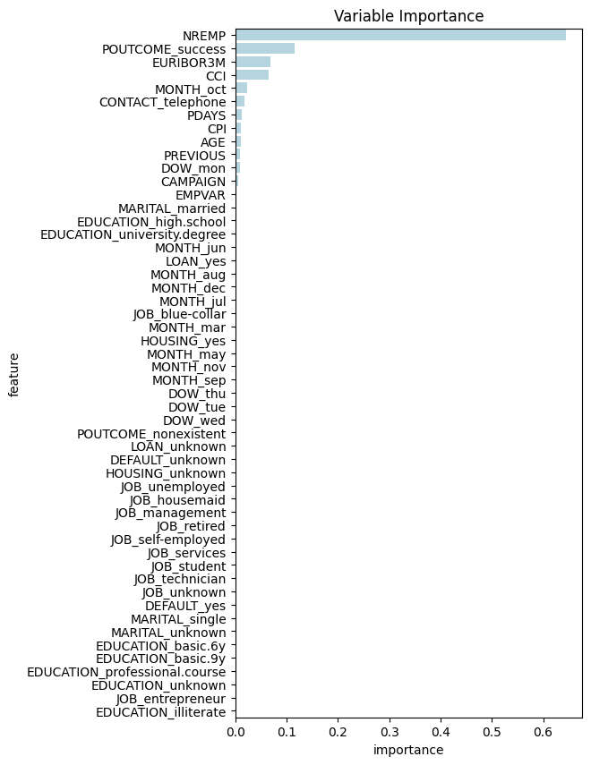
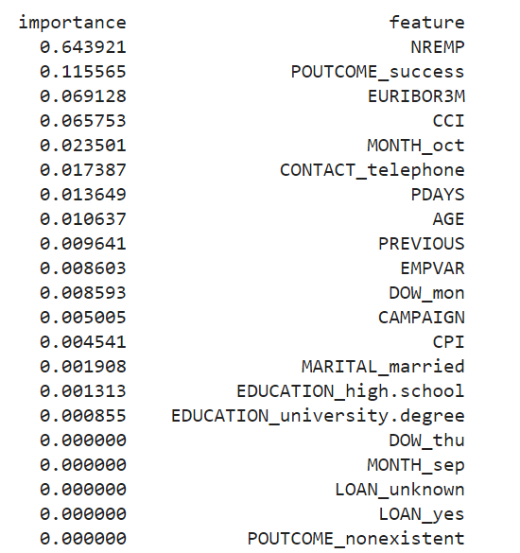
Feature Importance

Slide 9
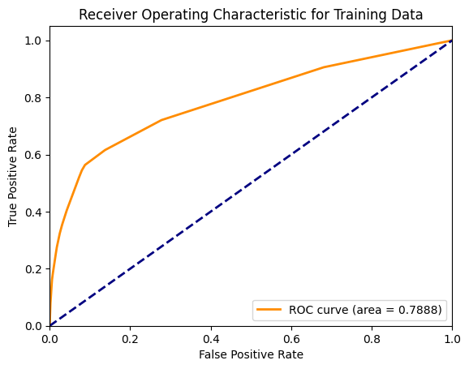
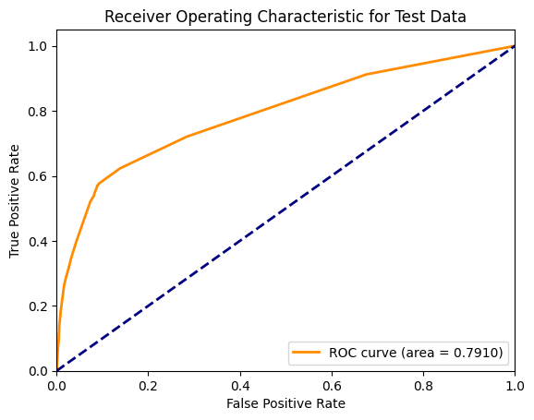
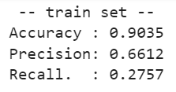
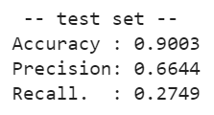
Model Assessment

Slide 10
Model Comparison
 | Accuracy (Train) | Precision (Train) | Recall (Train) | AUC (Train) | Accuracy (Test) | Precision (Test) | Recall (Test) | AUC (Test)
Full | 0.9010 | 0.6761 | 0.2150 | 0.7916 | 0.8990 | 0.6987 | 0.2195 | 0.7944
Stepwise | 0.9009 | 0.6748 | 0.2150 | 0.7916 | 0.8992 | 0.7043 | 0.2188 | 0.7946
L1 (0.1) | 0.9008 | 0.6809 | 0.2078 | 0.7912 | 0.8983 | 0.6988 | 0.2083 | 0.7944
L1 (0.01) | 0.9000 | 0.6836 | 0.1923 | 0.7782 | 0.8983 | 0.7128 | 0.1985 | 0.7842
L2 | 0.9001 | 0.6968 | 0.1889 | 0.7790 | 0.8984 | 0.8280 | 0.1914 | 0.7786
Elastic Net | 0.8980 | 0.6290 | 0.2063 | 0.7164 | 0.8965 | 0.6594 | 0.2132 | 0.7205
Decision Tree | 0.9035 | 0.6612 | 0.2757 | 0.7888 | 0.9003 | 0.6624 | 0.2749 | 0.7910

